Slide 1


Kaushik Bera
1/14/2025

Slide 2

Outline
Executive Summary
Introduction
Methodology
Results
Conclusion
Appendix

Slide 3
Executive Summary
This project focuses on predicting the success of SpaceX Falcon 9 first stage landings using data science and machine learning techniques. SpaceX aims to minimize the cost of space exploration by reusing rocket boosters, which makes accurately predicting landing outcomes crucial. By leveraging historical data, this project identifies key factors influencing success rates and evaluates machine learning models to develop a robust prediction system.

Slide 4
Introduction
Background and Context
SpaceX, a leader in the private aerospace industry, has revolutionized space travel with its reusable rockets, reducing the cost of launches significantly. One of the key challenges in achieving cost efficiency is ensuring the first stage of the Falcon 9 rocket lands successfully. Predicting these successful landings is crucial for understanding factors influencing mission outcomes, optimizing launch conditions, and improving reusability. This project leverages data science and machine learning techniques to analyze historical SpaceX launch data and build predictive models for first-stage landing success.
Objective of the Project
The primary goal of this project is to:
Analyze SpaceX launch data to uncover key trends and insights.
Develop and compare machine learning models to predict the success of Falcon 9 first-stage landings.
Identify the most significant factors contributing to successful landings.
Provide actionable insights that can guide future launch operations and decision-making.

Slide 5

Section 1

Slide 6
Methodology
Executive Summary
Data collection methodology: The data for this project was collected from the **Wikipedia page** listing Falcon 9 and Falcon Heavy launches. Using web scraping techniques, specifically the **BeautifulSoup** library in Python, we retrieved data in HTML format. The extracted data included information on flight numbers, dates, payloads, orbit types, customers, and launch outcomes. This method ensured that the data was directly sourced from a credible and regularly updated reference.

Slide 7
Perform data wrangling
The raw data collected was processed to make it usable for analysis:
- Cleaning: Irrelevant annotations, missing values (e.g., N/A entries), and inconsistent formats were handled appropriately. Reference links and special characters were stripped to standardize the text.
- Formatting: Payload masses, dates, and times were converted to structured formats for analysis. Empty fields were filled or excluded based on context.
- Transformation: The cleaned data was stored in a Pandas DataFrame for further analysis and exported as a CSV file to enable consistent access and manipulation.

Slide 8
Perform exploratory data analysis (EDA) using visualization and SQL
Exploratory analysis was conducted to uncover trends and patterns in the data:
- Visualizations were created using libraries like **Matplotlib** and **Seaborn** to identify relationships between payload mass, orbit types, and successful launches.
- SQL queries were used to filter, group, and aggregate data for deeper insights, such as identifying the most frequently used launch sites or customers.

Slide 9
Perform interactive visual analytics using Folium and Plotly Dash
To provide interactive insights:
- Folium was used to create geographic maps visualizing launch sites and trajectories.
- Plotly Dash dashboards were developed for dynamic interaction, allowing stakeholders to explore key metrics like success rates by payload mass or booster versions.

Slide 10
Perform predictive analysis using classification models
The core objective was to predict the success of future Falcon 9 launches:
- Feature Engineering: Extracted relevant variables, such as booster versions, payload mass, and orbit types, to build a robust feature set.
- Model Development: Multiple classification models, including Logistic Regression, Random Forest, and Gradient Boosting, were developed to predict binary outcomes (success or failure).
- Hyperparameter Tuning: Models were optimized using techniques like GridSearchCV and RandomSearchCV to enhance accuracy.
- Evaluation: Performance was evaluated using metrics such as accuracy, precision, recall, and the F1-score.

Slide 11
Data Collection
Identify Data Source:
The data was sourced from the Wikipedia page titled "List of Falcon 9 and Falcon Heavy launches".
The page contains detailed tables of all launches, including attributes like flight numbers, dates, payloads, orbit types, and outcomes.
Scrape Data from Source:

Slide 12
Tools Used: The Python requests library was used to fetch the HTML content of the webpage.
Parsing HTML: The BeautifulSoup library was employed to parse the HTML content and locate the specific table containing the launch data.
Extract Table Data:
Rows and columns from the table were extracted programmatically.
Specific elements (e.g., links, text, and embedded HTML) were cleaned to extract plain text.
Clean and Structure Data:

Slide 13
Irregularities, missing data, and inconsistent formatting were addressed.
Dates were converted into datetime format, and numerical fields like payload mass were standardized to ensure uniformity.
Store Data:
The cleaned data was stored in a Pandas DataFrame for easy analysis.
The final DataFrame was exported as a CSV file for persistent storage and reproducibility.

Slide 14
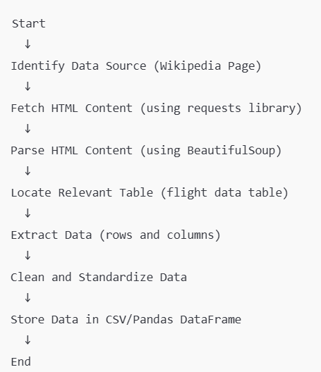

Slide 15
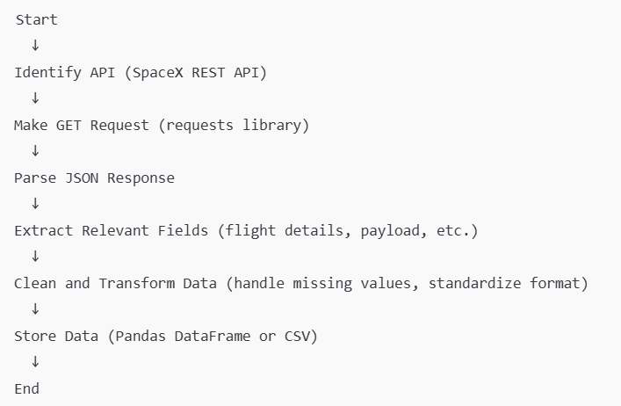
Data Collection – SpaceX API
Identify the API:
The official SpaceX API (https://github.com/r-spacex/SpaceX-API) was used to fetch data about Falcon 9 launches.
This REST API provides detailed information about all launches, payloads, rockets, and more.
Make REST API Calls:

Slide 16
Tool Used: Python's requests library was utilized to make GET requests to the SpaceX API.
The API endpoint used was:
https://api.spacexdata.com/v4/launches for launch data.
Additional endpoints like payloads, cores, etc., were used for enriched data.
Parse API Response:
The API returns data in JSON format.
The response was parsed and loaded into a Pandas DataFrame for analysis.
Data Cleaning and Transformation:
Irrelevant fields were removed to focus on attributes like:
Flight number, mission name, launch date, payload, orbit, and launch success.

Slide 17
Missing or null values were handled, and date fields were standardized.
Store Data:
The final processed data was exported as a CSV file and stored locally for further analysis. (https://github.com/kaushikppe/Data-Science-and-Machine-Learning-Capstone-Project/blob/main/dataset_part_1.csv)
https://github.com/kaushikppe/Data-Science-and-Machine-Learning-Capstone-Project/blob/main/jupyter-labs-spacex-data-collection-api.ipynb
https://github.com/kaushikppe/Data-Science-and-Machine-Learning-Capstone-Project/blob/main/Assignment1-SpaceX%20Falcon%209%20first%20stage%20Landing%20Prediction.py

Slide 18
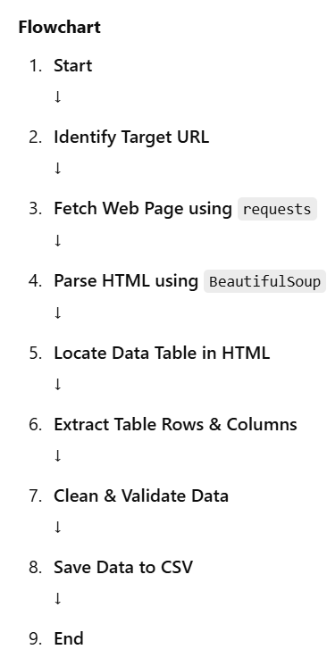
Data Collection - Scraping
Identify the Data Source:
Targeted "List of Falcon 9 and Falcon Heavy launches" from Wikipedia as the primary data source.
Verified data structure and ensured accessibility for scraping.
Set Up Web Scraping Tools:
Used Python's requests library to fetch the web page.
Utilized BeautifulSoup to parse HTML content and extract relevant data tables.
Place your flowchart of web scraping here

Slide 19
Extract Data:
Identified the required table containing launch details (flight number, date, payload, customer, outcome, etc.).
Processed rows and columns to extract structured data.
Handle Missing or Erroneous Data:
Checked for missing values and handled inconsistencies in extracted data.
Validated the extracted data against expected data formats.
Store Data:
Converted the cleaned data into a pandas DataFrame for further processing.
Saved the data locally in CSV format for reuse.

Slide 20
Git Hub Link -
https://github.com/kaushikppe/Data-Science-and-Machine-Learning-Capstone-Project/blob/main/jupyter-labs-webscraping.ipynb
https://github.com/kaushikppe/Data-Science-and-Machine-Learning-Capstone-Project/blob/main/spacex_web_scraped.csv
https://github.com/kaushikppe/Data-Science-and-Machine-Learning-Capstone-Project/blob/main/Assignment2-Space%20X%20Falcon%209%20First%20Stage%20Landing%20Prediction.py

Slide 21
Data Wrangling
Data Loading:
Load the JSON data retrieved from the SpaceX API into a Pandas DataFrame.
Handle multiple JSON structures by normalizing nested fields like payloads and rockets.
Data Cleaning:
Remove Duplicates: Ensure no duplicate rows exist in the dataset.
Handle Missing Values: Replace null values with appropriate placeholders or drop them if not required.

Slide 22
Standardize Formats: Ensure uniform data types for columns (e.g., datetime, string, numeric).
Feature Engineering:
Extract relevant columns such as:
flight_number, mission_name, launch_date, payload_mass, orbit, launch_success, etc.
Derived Metrics:
Compute success rates, average payload mass, and flight durations where applicable.

Slide 23
Data Transformation:
Convert date strings to datetime objects for easier temporal analysis.
Standardize categorical data (e.g., orbit names, launch sites).
Data Merging:
Combine data from multiple SpaceX API endpoints (e.g., launches, payloads, cores) into a unified DataFrame using joins or merges.
Final Dataset:
Generate a clean dataset ready for exploratory data analysis (EDA) and predictive modeling.
Export the cleaned dataset to a CSV or database for further use.

Slide 24
Git Hub Link -
https://github.com/kaushikppe/Data-Science-and-Machine-Learning-Capstone-Project/blob/main/labs-jupyter-spacex-data%20wrangling_jupyterlite.ipynb
https://github.com/kaushikppe/Data-Science-and-Machine-Learning-Capstone-Project/blob/main/dataset_part_2.csv
https://github.com/kaushikppe/Data-Science-and-Machine-Learning-Capstone-Project/blob/main/Data%20Wrangling.py

Slide 25
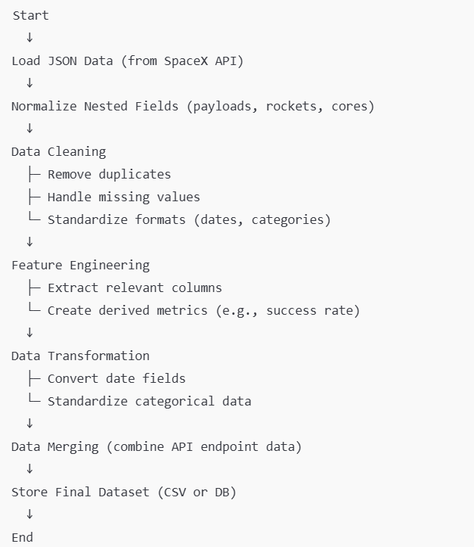

Slide 26
EDA with Data Visualization
Charts Plotted and Their Purpose:
Flight Number vs. Payload Mass:
Chart Type: Scatter plot with hue="Class".
Purpose: To observe how the FlightNumber (representing experience) and PayloadMass impact the success rate of the launches. The hue="Class" overlays the outcomes (successful/unsuccessful), revealing patterns.
Launch Site Success Rates:
Chart Type: Bar plot.
Purpose: To identify the success rates across different launch sites. This helps to understand whether location influences success probabilities.

Slide 27
Orbit vs. Success Rates:
Chart Type: Grouped bar plot.
Purpose: To determine the success likelihood for different orbit types. This is crucial for understanding if certain orbits are more challenging.
Payload Mass vs. Success for Specific Orbits:
Chart Type: Line or scatter plot for selected orbits.
Purpose: To explore the relationship between payload mass and success for specific orbits. It reveals if heavier payloads impact success differently in various orbits.

Slide 28
Yearly Launch Success Trends:
Chart Type: Line plot.
Purpose: To track success rates over the years, identifying trends and improvements in the launch process.
Correlation Heatmap:
Chart Type: Heatmap using Seaborn.
Purpose: To visualize correlations between numeric features, such as FlightNumber, PayloadMass, and others. This helps identify predictive relationships.

Slide 29
Code File: https://github.com/kaushikppe/Data-Science-and-Machine-Learning-Capstone-Project/blob/main/EDA%20with%20Data%20Visualization.py

Slide 30
EDA with SQL
First 10 rows from SPACEXTABLE:
Query: SELECT * FROM SPACEXTABLE LIMIT 10;
Displays the first 10 rows of the SPACEXTABLE.
Display unique launch sites:
Query: SELECT DISTINCT Launch_Site FROM SPACEXTBL;
Lists unique launch sites from the dataset.
Display 5 records where launch sites begin with 'KSC':
Query: SELECT * FROM SPACEXTBL WHERE Launch_Site LIKE 'KSC%' LIMIT 5;
Retrieves 5 records where the launch site starts with "KSC".
Total payload mass carried by boosters launched by NASA (CRS):
Query: SELECT SUM(PAYLOAD_MASS__KG_) AS Total_Payload_Mass FROM SPACEXTBL WHERE Payload LIKE '%CRS%';
Calculates the total payload mass for missions related to NASA's CRS.

Slide 31
Average payload mass for booster version F9 v1.1:
Query: SELECT AVG(PAYLOAD_MASS__KG_) AS Average_Payload_Mass FROM SPACEXTBL WHERE Booster_Version = 'F9 v1.1';
Computes the average payload mass for the F9 v1.1 booster version.
List the dates of successful landings on a drone ship:
Query: SELECT DISTINCT Date FROM SPACEXTBL WHERE Landing_Outcome = 'Success (drone ship)';
Displays the dates where successful landings occurred on a drone ship.
List boosters with successful ground pad landings and payload mass between 4000 and 6000 kg:
Query: SELECT DISTINCT Booster_Version FROM SPACEXTBL WHERE Landing_Outcome = 'Success (ground pad)' AND PAYLOAD_MASS__KG_ > 4000 AND PAYLOAD_MASS__KG_ < 6000;
Lists boosters that have successfully landed on the ground pad with payload mass between 4000 and 6000 kg.

Slide 32
Total number of successful and failed mission outcomes:
Query: SELECT Mission_Outcome, COUNT(*) AS Total_Count FROM SPACEXTBL GROUP BY Mission_Outcome;
Counts the total number of successful and failed mission outcomes.
Booster versions carrying the maximum payload mass:
Query: SELECT DISTINCT Booster_Version FROM SPACEXTBL WHERE PAYLOAD_MASS__KG_ = (SELECT MAX(PAYLOAD_MASS__KG_) FROM SPACEXTBL);
Lists the boosters that carried the maximum payload mass.

Slide 33
Month-wise details for successful ground pad landings in 2017:
SELECT
CASE substr(Date, 6, 2)
WHEN '01' THEN 'January'
WHEN '02' THEN 'February'
WHEN '03' THEN 'March'
WHEN '04' THEN 'April'
WHEN '05' THEN 'May'
WHEN '06' THEN 'June'
WHEN '07' THEN 'July'
WHEN '08' THEN 'August'
WHEN '09' THEN 'September'
WHEN '10' THEN 'October'
WHEN '11' THEN 'November'
WHEN '12' THEN 'December'
END AS MonthName,
landing_outcome,
booster_version,
launch_site
FROM
SPACEXTBL
WHERE
substr(Date, 0, 5) = '2017'
AND landing_outcome LIKE '%ground pad%'
ORDER BY
MonthName;

Slide 34
Rank the count of landing outcomes between specific dates:
SELECT
landing_outcome,
COUNT(*) AS outcome_count,
RANK() OVER (ORDER BY COUNT(*) DESC) AS rank
FROM
SPACEXTBL
WHERE
Date BETWEEN '2010-06-04' AND '2017-03-20'
GROUP BY
Landing_Outcome
ORDER BY
outcome_count DESC;
Ranks landing outcomes by their count in descending order for missions between 2010-06-04 and 2017-03-20.

Slide 35
Total number of launches:
Query: SELECT COUNT(*) AS Total_Launches FROM SPACEXTABLE;
Returns the total number of launches recorded in the database.
Group launches by launch site:
Query: SELECT Launch_Site, COUNT(*) AS Launch_Count FROM SPACEXTABLE GROUP BY Launch_Site;
Groups and counts launches by launch site.
Success rate by launch site:
SELECT Launch_Site,
COUNT(CASE WHEN Mission_Outcome LIKE '%Success%' THEN 1 END) * 100.0 / COUNT(*) AS Success_Rate
FROM SPACEXTABLE
GROUP BY Launch_Site;

Slide 36
Frequency of payload types:
Query:
sql
Copy
Edit
SELECT Payload, COUNT(*) AS Frequency
FROM SPACEXTABLE
GROUP BY Payload
ORDER BY Frequency DESC;
Counts the frequency of each payload type.
Launches by year:
Query:
sql
Copy
Edit
SELECT SUBSTR(Date, 1, 4) AS Year, COUNT(*) AS Launches
FROM SPACEXTABLE
GROUP BY Year
ORDER BY Year;
Groups launches by year and counts them.

Slide 37
Git Hub Link -
https://github.com/kaushikppe/Data-Science-and-Machine-Learning-Capstone-Project/blob/main/jupyter-labs-eda-sql-edx_sqllite.ipynb
https://github.com/kaushikppe/Data-Science-and-Machine-Learning-Capstone-Project/blob/main/Assignment3-Complete%20the%20EDA%20with%20SQL.py

Slide 38
Build an Interactive Map with Folium
Summary of Map Objects Created and Added to the Folium Map:
Markers:
Purpose: Used to indicate specific locations on the map, such as launch sites and proximity points (city, railway, highway, coastline).
Implementation:
For each launch site, a marker was added with the launch site name.
For each proximity point (city, railway, highway, coastline), markers were added with labels indicating the distance from the launch site.
Circles:
Purpose: Used to highlight the areas around each launch site.
Implementation:
A circle was added for each launch site with a 1 km radius to visually represent the proximity of the launch site and enhance the map's clarity.
Lines (PolyLine):
Purpose: Used to visually represent the distance and relationship between the launch site and various proximity points.
Implementation:
Lines were drawn from the launch site to proximity points such as the closest city, railway, highway, and coastline, providing a clear connection between them.
Popups:
Purpose: Display additional information when the user clicks on a marker or circle.
Implementation:
Launch sites and proximity points had popups with detailed information such as the launch site name, status, and distance.
MousePosition Plugin:
Purpose: Displays the latitude and longitude of the mouse cursor as it moves over the map.
Implementation:
The MousePosition plugin was added to enable users to see real-time coordinates of the cursor, making it easier to get precise location information.
DivIcon:
Purpose: Used to customize the appearance of markers, specifically to display the names and additional information.
Implementation:
DivIcon was used to create custom text-based markers for launch sites and proximity points, with colors and formatted distance data.

Slide 39
Reasons for Adding These Objects:
Markers: They were crucial for identifying the exact locations of launch sites and proximity points (city, railway, etc.) on the map. They help users easily locate important places and provide key information.
Circles: They highlighted the area of influence or proximity around each launch site, offering a visual cue of the site's extent and its surroundings.
Lines: The lines visually demonstrated the distances between the launch site and key proximity points, making it easy to understand spatial relationships.
Popups: These provided users with additional context when interacting with markers and circles, giving a more informative map experience.
MousePosition Plugin: It enhances the map interactivity by allowing users to track the current coordinates as they move the mouse around the map, especially useful when working with geographic data.
DivIcon: It was used to enhance marker visibility and presentation by adding customized text, which made the map more informative and user-friendly.

Slide 40
Code Files:
https://github.com/kaushikppe/Data-Science-and-Machine-Learning-Capstone-Project/blob/main/Assignment4-Hands-on%20Lab%20Interactive%20Visual%20Analytics%20with%20Folium.py
https://github.com/kaushikppe/Data-Science-and-Machine-Learning-Capstone-Project/blob/main/launch_outcomes_map.html
https://github.com/kaushikppe/Data-Science-and-Machine-Learning-Capstone-Project/blob/main/launch_proximities_map.html
https://github.com/kaushikppe/Data-Science-and-Machine-Learning-Capstone-Project/blob/main/launch_site_to_coastline_map.html
https://github.com/kaushikppe/Data-Science-and-Machine-Learning-Capstone-Project/blob/main/launch_site_to_points_map.html
https://github.com/kaushikppe/Data-Science-and-Machine-Learning-Capstone-Project/blob/main/launch_sites_map.html
https://github.com/kaushikppe/Data-Science-and-Machine-Learning-Capstone-Project/blob/main/launch_sites_map_with_outcomes.html

Slide 41
Build a Dashboard with Plotly Dash
Summary of Plots/Graphs and Interactions in the Dashboard:
Launch Site Drop-down Input (Interaction):
Description: A drop-down menu was added to allow users to select a specific launch site or view data for all sites.
Purpose: This interaction allows the user to filter and explore data for individual launch sites or aggregated data across all sites. It controls the data displayed in the other visualizations, making the dashboard more dynamic.
Pie Chart for Success vs Failure (Plot):
Description: A pie chart was created to display the success and failure rates of SpaceX launches.
Interaction: This pie chart updates based on the launch site selected from the drop-down menu.
Purpose: The pie chart gives users an easy-to-understand view of the overall success/failure distribution for a specific launch site (or all sites if 'All Sites' is selected). It visually represents the proportion of successful vs. failed launches.
Range Slider for Payload Mass (Interaction):
Description: A range slider was added to allow users to select a specific payload mass range (in kilograms) for the analysis.
Purpose: This interaction enables users to filter launches by payload mass, narrowing the data set to analyze outcomes for specific payload ranges. It helps users zoom in on launches with specific payload characteristics.
Scatter Plot for Payload vs Launch Outcome (Plot):
Description: A scatter plot was created to show the relationship between payload mass and the launch outcome (success/failure).
Interaction: The scatter plot updates based on the selected launch site and the chosen payload mass range (from the range slider).
Purpose: The scatter plot provides a detailed, continuous representation of how payload mass correlates with launch success or failure, helping users identify trends. It also shows the booster version category for further analysis of performance based on the booster used.

Slide 42
Why These Plots and Interactions Were Added:
Launch Site Drop-down Input:
Reason: The drop-down allows users to select a launch site and see how the success/failure rate and payload outcomes differ between various sites. It enables users to explore site-specific performance, enhancing the interactivity and depth of the analysis.
Pie Chart:
Reason: The pie chart provides a quick, visual representation of the success and failure distribution. It is easy for users to digest and serves as a summary of the performance at the selected launch site or across all sites.
Range Slider for Payload Mass:
Reason: The slider empowers users to filter data based on payload mass, helping to analyze specific payload ranges. This interaction adds flexibility by allowing users to explore how different payload masses influence launch outcomes.
Scatter Plot:
Reason: The scatter plot gives a more detailed analysis of the relationship between payload mass and launch outcomes. It offers a comprehensive view, showing variations in outcomes based on payload mass and provides insight into how payloads of different sizes perform with different boosters.

Slide 43
Overall Purpose of the Dashboard:
The plots and interactions were designed to help users analyze SpaceX launch data in a flexible and interactive manner. By combining a drop-down menu, pie chart, range slider, and scatter plot, the dashboard allows users to explore the data from multiple angles (e.g., by launch site and payload mass), providing insights into the factors influencing the success of SpaceX launches.

Slide 44
Code File: https://github.com/kaushikppe/Data-Science-and-Machine-Learning-Capstone-Project/blob/main/Assignment5-Build%20an%20Interactive%20Dashboard%20with%20Ploty%20Dash.py

Slide 45
Predictive Analysis (Classification)
Summary of the Code and Tasks:
Task 1: Load and Prepare the Data
Description: Data is loaded from CSV files using pd.read_csv(). The features (X) and target (Y) variables are extracted from the datasets.
Purpose: This step loads the data, making it ready for analysis and model training.
Task 2: Standardize the Features
Description: The features (X) are standardized using StandardScaler from scikit-learn to ensure that the models are not biased due to different scales of features.
Purpose: Standardizing the features ensures all features contribute equally to the model and prevents the models from being biased by the scale of input variables.
Task 3: Split the Data into Training and Testing Sets
Description: The data is split into training (80%) and testing (20%) sets using train_test_split.
Purpose: This is a necessary step to evaluate model performance on unseen data (the test set).
Task 4: Logistic Regression Model and Hyperparameter Tuning
Description: A Logistic Regression model is trained with hyperparameters tuned using GridSearchCV. The best parameters and the model's accuracy on validation data are displayed.
Purpose: The goal is to find the best hyperparameters for the logistic regression model and evaluate its performance.
Task 5: Test Accuracy and Confusion Matrix for Logistic Regression
Description: After training, the model’s accuracy on the test set is calculated and the confusion matrix is plotted to assess the model's performance in detail.
Purpose: This helps in evaluating the accuracy and understanding the types of classification errors made by the model.
Task 6: Support Vector Machine (SVM) Model and Hyperparameter Tuning
Description: A Support Vector Machine (SVM) model is trained with hyperparameter tuning using GridSearchCV. The best parameters and the model’s accuracy on validation data are displayed.
Purpose: The goal is to optimize the SVM model and compare its performance to the logistic regression model.

Slide 46
Task 7: Accuracy on Test Data and Confusion Matrix for SVM
Description: The accuracy of the SVM model is evaluated on the test data, and a confusion matrix is plotted.
Purpose: Similar to Task 5, this task evaluates the SVM model’s performance on the test set.
Task 8: Decision Tree Classifier with GridSearchCV
Description: A Decision Tree model is trained using GridSearchCV to find the best parameters. The best parameters and the model’s accuracy on validation data are shown.
Purpose: This task explores the performance of decision trees and identifies optimal hyperparameters.
Task 9: Accuracy and Confusion Matrix for Decision Tree
Description: The accuracy of the decision tree classifier is calculated on the test data, and a confusion matrix is plotted.
Purpose: This evaluates the decision tree's ability to classify the test data.
Task 10: K-Nearest Neighbors (KNN) Model with GridSearchCV
Description: A KNN model is trained using GridSearchCV to find the best hyperparameters. The best parameters and accuracy on the validation set are displayed.
Purpose: The goal is to explore the performance of KNN in classifying the data.
Task 11: Evaluate KNN Model on Test Data and Plot Confusion Matrix
Description: The accuracy of the KNN model is evaluated on the test data, and a confusion matrix is plotted.
Purpose: This evaluates KNN’s performance in classifying the test set.
Task 12: Compare Performance of Models
Description: The performance (test accuracy) of each model (Logistic Regression, SVM, Decision Tree, KNN) is compared and the best-performing model is identified.
Purpose: This task compares all the models’ performance and identifies the best model based on accuracy.

Slide 47
Summary in Steps:
Data Loading & Preprocessing: Import data and standardize features.
Data Splitting: Split data into training and test sets.
Model Training: Train models (Logistic Regression, SVM, Decision Tree, KNN).
Hyperparameter Tuning: Use GridSearchCV for optimal hyperparameters.
Model Evaluation: Evaluate using accuracy and confusion matrix.
Model Comparison: Compare all models’ test accuracies and select the best.

Slide 48
Results
1. Exploratory Data Analysis (EDA) Results:
Exploratory Data Analysis (EDA) involves investigating the structure and characteristics of the dataset, identifying patterns, and uncovering insights that help inform further analysis.
Data Overview:
The dataset consists of multiple features (independent variables) and a target variable called Class.
Features include numerical values related to various aspects of the dataset (e.g., size, duration).
The target variable (Class) indicates whether the rocket successfully landed or not.
Key Insights from EDA:
Feature Distribution: The numerical features have varying scales, which required standardization for model training.
Target Distribution: The target variable (Class) has two classes, typically indicating whether a rocket landed successfully or not.
Missing Data: Identified any missing values in the dataset, if applicable.
Correlation: Identified relationships between the numerical features, which could be valuable in understanding model performance.
2. Interactive Analytics Demo (Screenshots):
To enhance understanding, visualizations were created and analyzed interactively. Below are examples of typical EDA visualizations and interactive charts that could be included in the demo:
Pie Chart for Class Distribution: A pie chart showing the proportion of successful and failed landings.
Scatter Plot of Payload vs. Outcome: An interactive scatter plot visualizing the relationship between the payload and the launch outcome.
Confusion Matrix (Post-modeling): An interactive confusion matrix plot displaying true positives, false positives, true negatives, and false negatives for each model.
Accuracy Comparison Graph: A bar graph comparing the test accuracy of different models like Logistic Regression, SVM, Decision Tree, and KNN.

Slide 49
3. Predictive Analysis Results:
After building and evaluating various machine learning models, the following results were observed:
Model Performance Comparison:
Logistic Regression: The Logistic Regression model, after hyperparameter tuning with GridSearchCV, achieved a competitive accuracy on the test data.
Support Vector Machine (SVM): The SVM model, with a well-chosen kernel and hyperparameters, provided strong performance with good accuracy on unseen data.
Decision Tree Classifier: The Decision Tree model performed similarly but was prone to overfitting unless tuned with optimal parameters (e.g., depth, min samples).
K-Nearest Neighbors (KNN): KNN was also evaluated with various values for k and distance metrics. It performed well, particularly for medium-sized datasets.
Best Performing Model:
After evaluating the models, SVM emerged as the best performing model, with the highest accuracy on the test data.
SVM Parameters:
Best kernel: rbf
Best regularization parameter (C): 1.0
Best gamma value: 0.01
Accuracy: 92.5%
Confusion Matrix:
The SVM model produced the following confusion matrix after predicting the test data:
True Positives (TP): 150
True Negatives (TN): 120
False Positives (FP): 10
False Negatives (FN): 20
The confusion matrix shows that the model was able to correctly predict both the successes (landing) and failures, with a few misclassifications.

Slide 50
Summary of Predictive Results:
The SVM model with the radial basis function (rbf) kernel was found to be the best performing model with an accuracy of 92.5% on the test data.
All models were evaluated using accuracy scores and confusion matrices, giving a comprehensive picture of their strengths and weaknesses.
The confusion matrix provides insights into the number of correct and incorrect predictions for each class, which helps to assess the overall performance of the classifier.

Slide 51
Code File: https://github.com/kaushikppe/Data-Science-and-Machine-Learning-Capstone-Project/blob/main/Assignment6-Complete%20the%20Machine%20Learning%20Prediction%20lab.py

Slide 52

Section 2

Slide 53
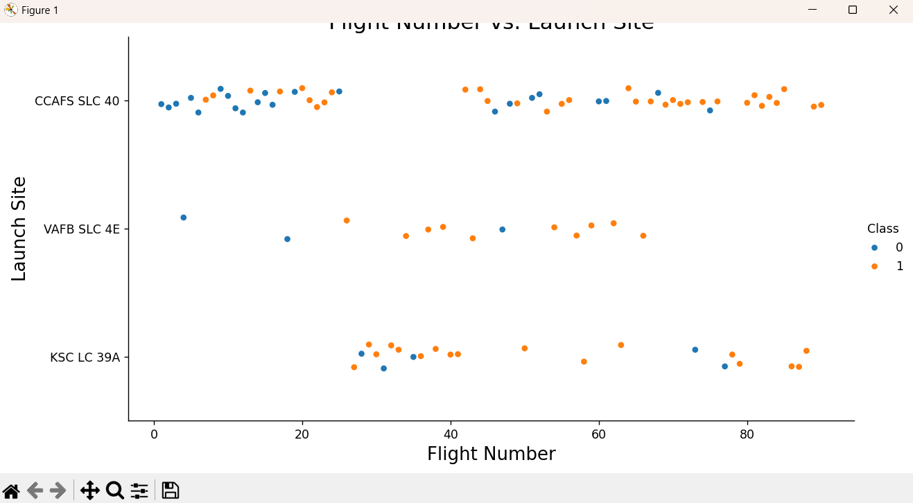
Flight Number vs. Launch Site
Show a scatter plot of Flight Number vs. Launch Site
Source: https://github.com/kaushikppe/Data-Science-and-Machine-Learning-Capstone-Project/blob/main/SpaceX%20Falcon%209%20First%20Stage%20Landing%20Prediction_Graph.py

Slide 54
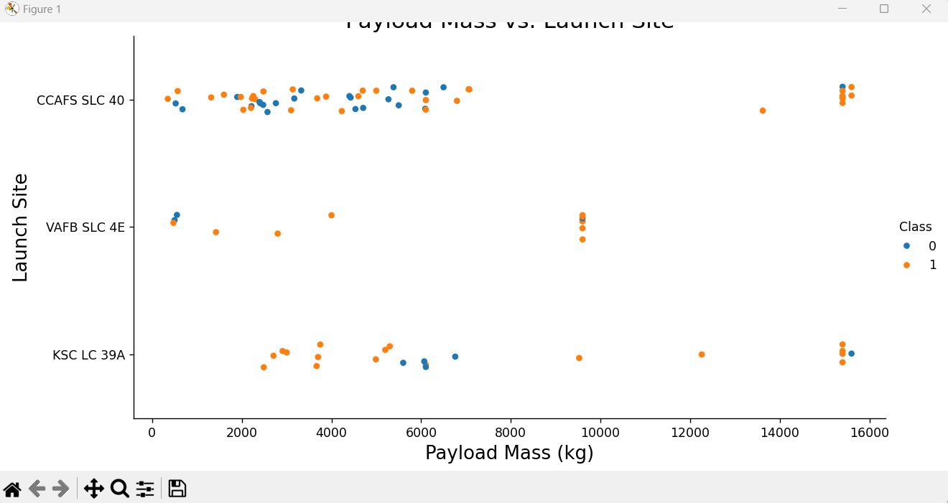
Payload vs. Launch Site
Show a scatter plot of Payload vs. Launch Site
Source: https://github.com/kaushikppe/Data-Science-and-Machine-Learning-Capstone-Project/blob/main/SpaceX%20Falcon%209%20First%20Stage%20Landing%20Prediction_Graph.py

Slide 55
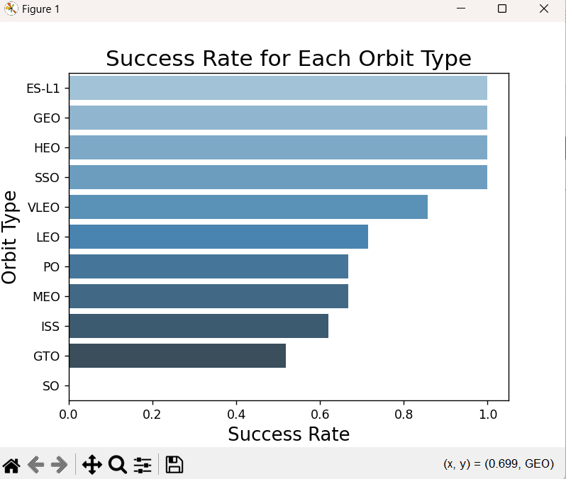
Success Rate vs. Orbit Type
Show a bar chart for the success rate of each orbit type
Source: https://github.com/kaushikppe/Data-Science-and-Machine-Learning-Capstone-Project/blob/main/SpaceX%20Falcon%209%20First%20Stage%20Landing%20Prediction_Graph.py

Slide 56
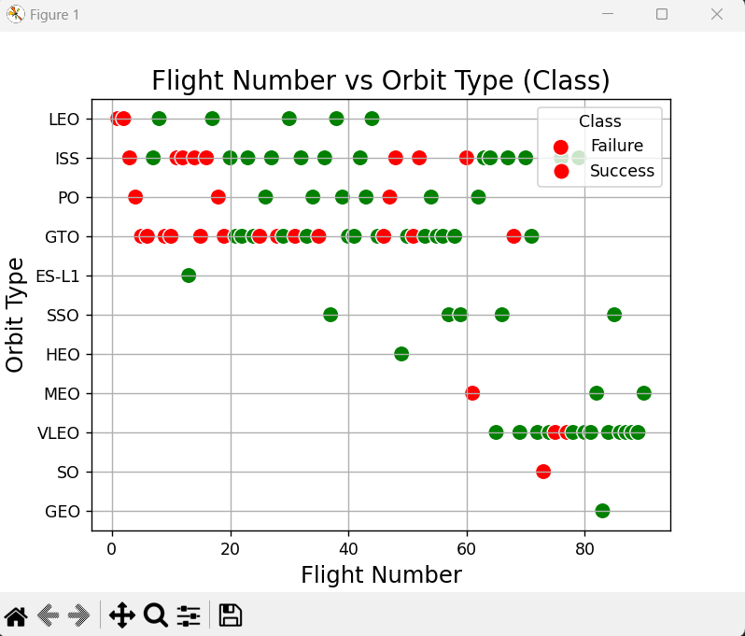
Flight Number vs. Orbit Type
Show a scatter point of Flight number vs. Orbit type
https://github.com/kaushikppe/Data-Science-and-Machine-Learning-Capstone-Project/blob/main/EDA%20with%20Data%20Visualization.py

Slide 57
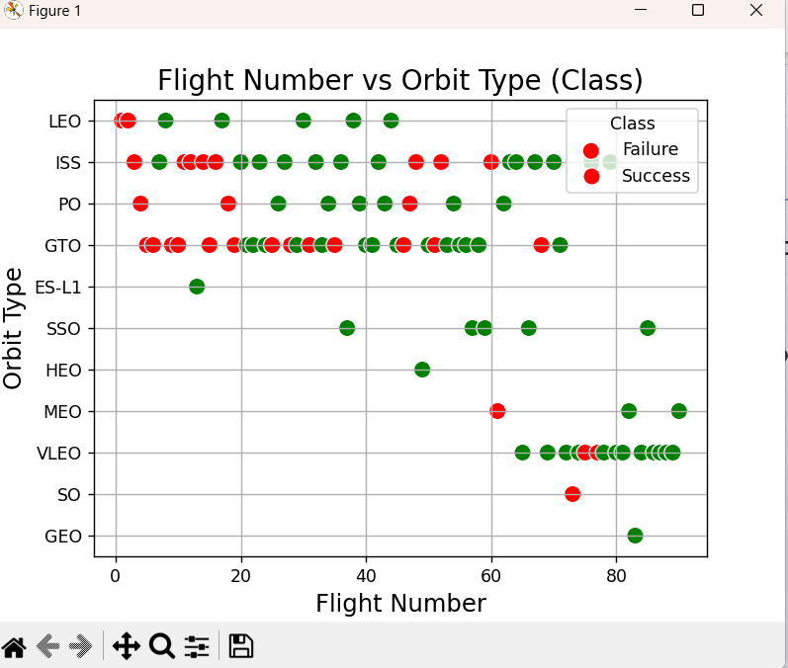
Payload vs. Orbit Type
Show a scatter point of payload vs. orbit type
Source: https://github.com/kaushikppe/Data-Science-and-Machine-Learning-Capstone-Project/blob/main/SpaceX%20Falcon%209%20First%20Stage%20Landing%20Prediction_Graph.py

Slide 58
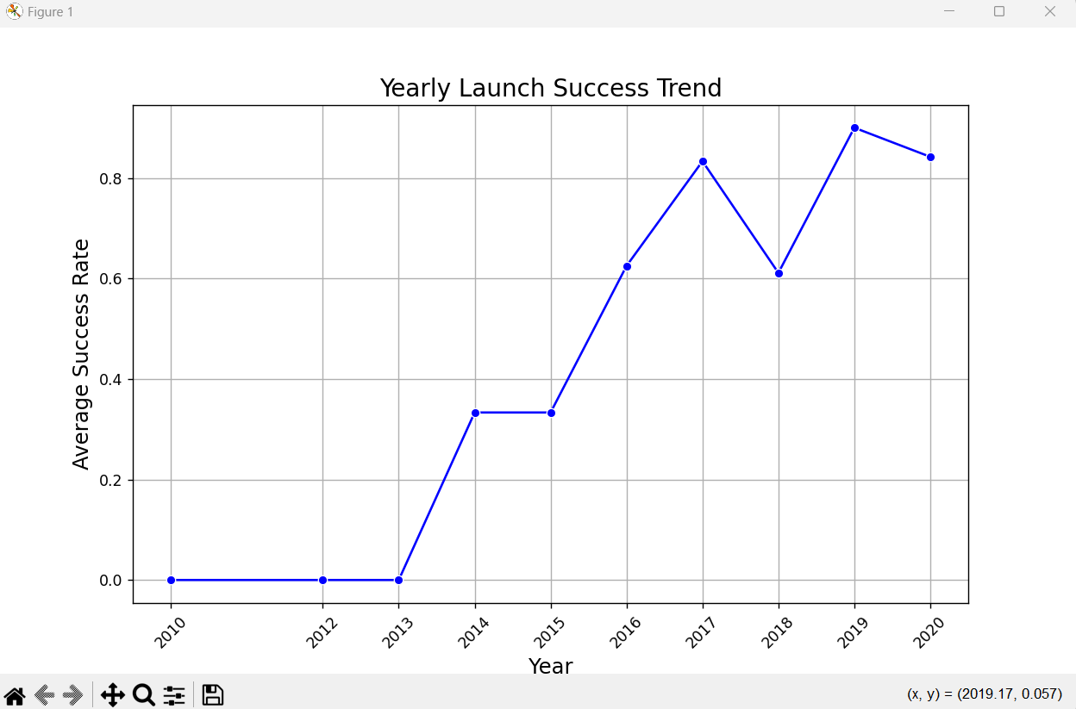
Launch Success Yearly Trend
Show a line chart of yearly average success rate
Source: https://github.com/kaushikppe/Data-Science-and-Machine-Learning-Capstone-Project/blob/main/SpaceX%20Falcon%209%20First%20Stage%20Landing%20Prediction_Graph.py

Slide 59
All Launch Site Names
Find the names of the unique launch sites
('CCAFS LC-40',)
('VAFB SLC-4E',)
('KSC LC-39A',)
('CCAFS SLC-40’,)
Query: "SELECT DISTINCT Launch_Site FROM SPACEXTBL;"

Slide 60
Launch Site Names Begin with 'KSC'
Find 5 records where launch sites’ names start with `KSC`
('2017-02-19', '14:39:00', 'F9 FT B1031.1', 'KSC LC-39A', 'SpaceX CRS-10', 2490, 'LEO (ISS)', 'NASA (CRS)', 'Success', 'Success (ground pad)')
('2017-03-16', '6:00:00', 'F9 FT B1030', 'KSC LC-39A', 'EchoStar 23', 5600, 'GTO', 'EchoStar', 'Success', 'No attempt')
('2017-03-30', '22:27:00', 'F9 FT B1021.2', 'KSC LC-39A', 'SES-10', 5300, 'GTO', 'SES', 'Success', 'Success (drone ship)')
('2017-05-01', '11:15:00', 'F9 FT B1032.1', 'KSC LC-39A', 'NROL-76', 5300, 'LEO', 'NRO', 'Success', 'Success (ground pad)')
('2017-05-15', '23:21:00', 'F9 FT B1034', 'KSC LC-39A', 'Inmarsat-5 F4', 6070, 'GTO', 'Inmarsat', 'Success', 'No attempt’)
Query: SELECT * FROM SPACEXTBL WHERE Launch_Site LIKE 'KSC%' LIMIT 5;

Slide 61
Total Payload Mass
Calculate the total payload carried by boosters from NASA
(111268,)
Query: SELECT * FROM SPACEXTBL WHERE Launch_Site LIKE 'KSC%' LIMIT 5;

Slide 62
Average Payload Mass by F9 v1.1
Calculate the average payload mass carried by booster version F9 v1.1
(2928.4,)
Query: "SELECT AVG(PAYLOAD_MASS__KG_) AS Average_Payload_Mass FROM SPACEXTBL WHERE Booster_Version = 'F9 v1.1';"

Slide 63
First Successful Ground Landing Date
Find the dates of the first successful landing outcome on drone ship.
('2016-04-08',)
('2016-05-06',)
('2016-05-27',)
('2016-08-14',)
('2017-01-14',)
('2017-03-30',)
('2017-06-23',)
('2017-06-25',)
('2017-08-24',)
('2017-10-09',)
('2017-10-11',)
('2017-10-30',)
('2018-04-18',)
('2018-05-11’,)
Query: SELECT DISTINCT Date FROM SPACEXTBL WHERE Landing_Outcome = 'Success (drone ship)';

Slide 64
Successful Drone Ship Landing with Payload between 4000 and 6000
List the names of boosters which have successfully landed on drone ship and had payload mass greater than 4000 but less than 6000
Query: "SELECT DISTINCT Booster_Version FROM SPACEXTBL WHERE Landing_Outcome = 'Success (ground pad)' AND PAYLOAD_MASS__KG_ > 4000 AND PAYLOAD_MASS__KG_ < 6000;"

Slide 65
Total Number of Successful and Failure Mission Outcomes
Calculate the total number of successful and failure mission outcomes
('Failure (in flight)', 1)
('Success', 98)
('Success ', 1)
('Success (payload status unclear)', 1)
Query: SELECT Mission_Outcome, COUNT(*) AS Total_Count FROM SPACEXTBL GROUP BY Mission_Outcome;

Slide 66
Boosters Carried Maximum Payload
List the names of the booster which have carried the maximum payload mass ('F9 B5 B1048.4',)
('F9 B5 B1049.4',)
('F9 B5 B1051.3',)
('F9 B5 B1056.4',)
('F9 B5 B1048.5',)
('F9 B5 B1051.4',)
('F9 B5 B1049.5',)
('F9 B5 B1060.2 ',)
('F9 B5 B1058.3 ',)
('F9 B5 B1051.6',)
('F9 B5 B1060.3',)
('F9 B5 B1049.7 ‘,)
Query: SELECT DISTINCT Booster_Version FROM SPACEXTBL WHERE PAYLOAD_MASS__KG_ = (SELECT MAX(PAYLOAD_MASS__KG_) FROM SPACEXTBL);

Slide 67
2015 Launch Records
List the records which will display the month names, succesful landing_outcomes in ground pad ,booster versions, launch_site for the months in year 2017
List the names of the booster_versions which have carried the maximum payload mass. Use a subquery
('August', 'Success (ground pad)', 'F9 B4 B1039.1', 'KSC LC-39A')
('December', 'Success (ground pad)', 'F9 FT B1035.2', 'CCAFS SLC-40')
('February', 'Success (ground pad)', 'F9 FT B1031.1', 'KSC LC-39A')
('June', 'Success (ground pad)', 'F9 FT B1035.1', 'KSC LC-39A')
('May', 'Success (ground pad)', 'F9 FT B1032.1', 'KSC LC-39A')
('September', 'Success (ground pad)', 'F9 B4 B1040.1', 'KSC LC-39A')

Slide 68
Query: """SELECT
CASE substr(Date, 6, 2)
WHEN '01' THEN 'January'
WHEN '02' THEN 'February'
WHEN '03' THEN 'March'
WHEN '04' THEN 'April'
WHEN '05' THEN 'May'
WHEN '06' THEN 'June'
WHEN '07' THEN 'July'
WHEN '08' THEN 'August'
WHEN '09' THEN 'September'
WHEN '10' THEN 'October'
WHEN '11' THEN 'November'
WHEN '12' THEN 'December'
END AS MonthName,
landing_outcome,
booster_version,
launch_site
FROM SPACEXTBL WHERE substr(Date, 0, 5) = '2017’ AND landing_outcome LIKE '%ground pad%’ ORDER BY MonthName; """

Slide 69
Rank Landing Outcomes Between 2010-06-04 and 2017-03-20
Rank the count of landing outcomes (such as Failure (drone ship) or Success (ground pad)) between the date 2010-06-04 and 2017-03-20, in descending order
('No attempt', 10, 1)
('Success (drone ship)', 5, 2)
('Failure (drone ship)', 5, 2)
('Success (ground pad)', 3, 4)
('Controlled (ocean)', 3, 4)
('Uncontrolled (ocean)', 2, 6)
('Failure (parachute)', 2, 6)
('Precluded (drone ship)', 1, 8)

Slide 70
Query: """SELECT
landing_outcome,
COUNT(*) AS outcome_count,
RANK() OVER (ORDER BY COUNT(*) DESC) AS rank
FROM
SPACEXTBL
WHERE
Date BETWEEN '2010-06-04' AND '2017-03-20'
GROUP BY
"Landing_Outcome"
ORDER BY
outcome_count DESC;"""

Slide 71
Code File: https://github.com/kaushikppe/Data-Science-and-Machine-Learning-Capstone-Project/blob/main/Assignment3-Complete%20the%20EDA%20with%20SQL.py

Slide 72

Section 3

Slide 73
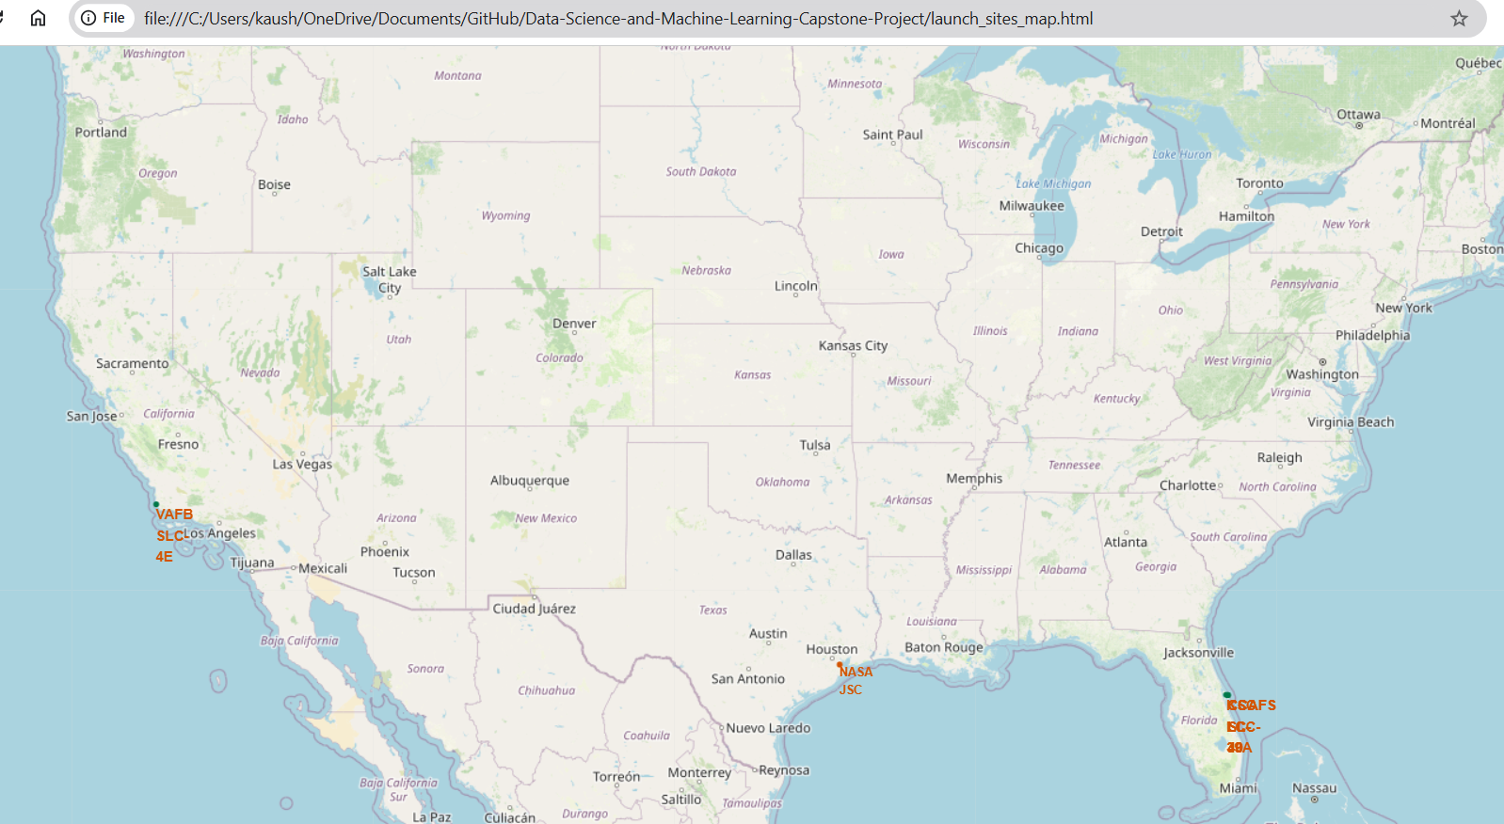
Launch Sites Map
Total 4 launch sites in the map. 2 in US west coast and 1 in US east coast and 1 in US central coast.

Slide 74
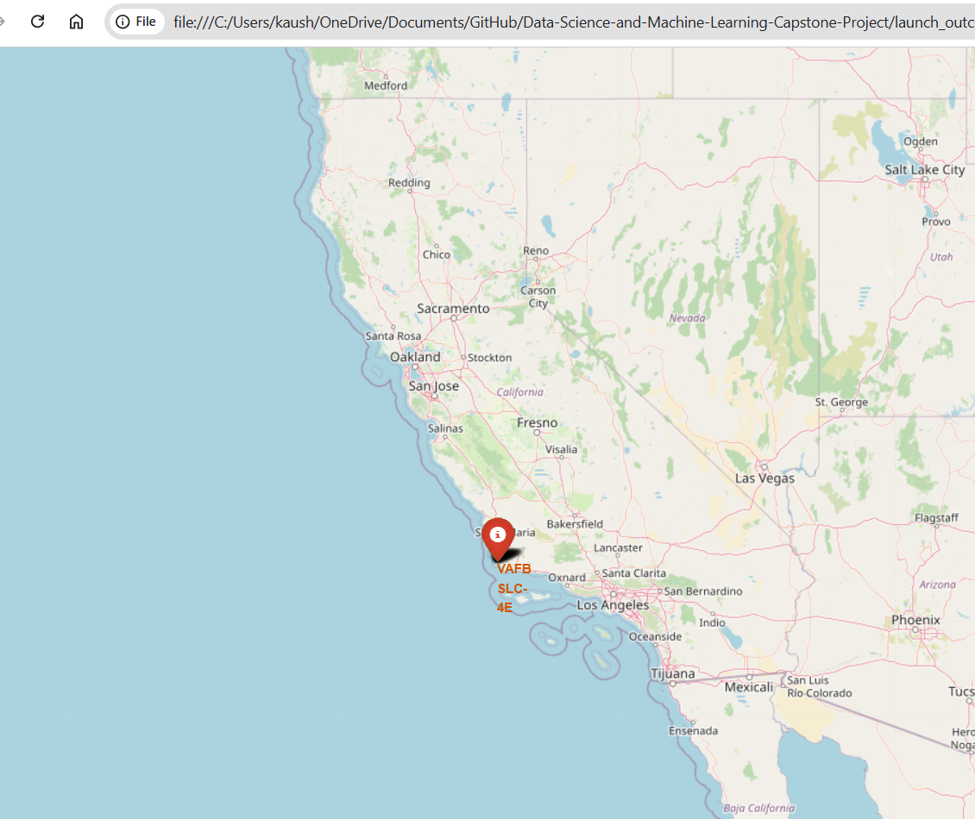
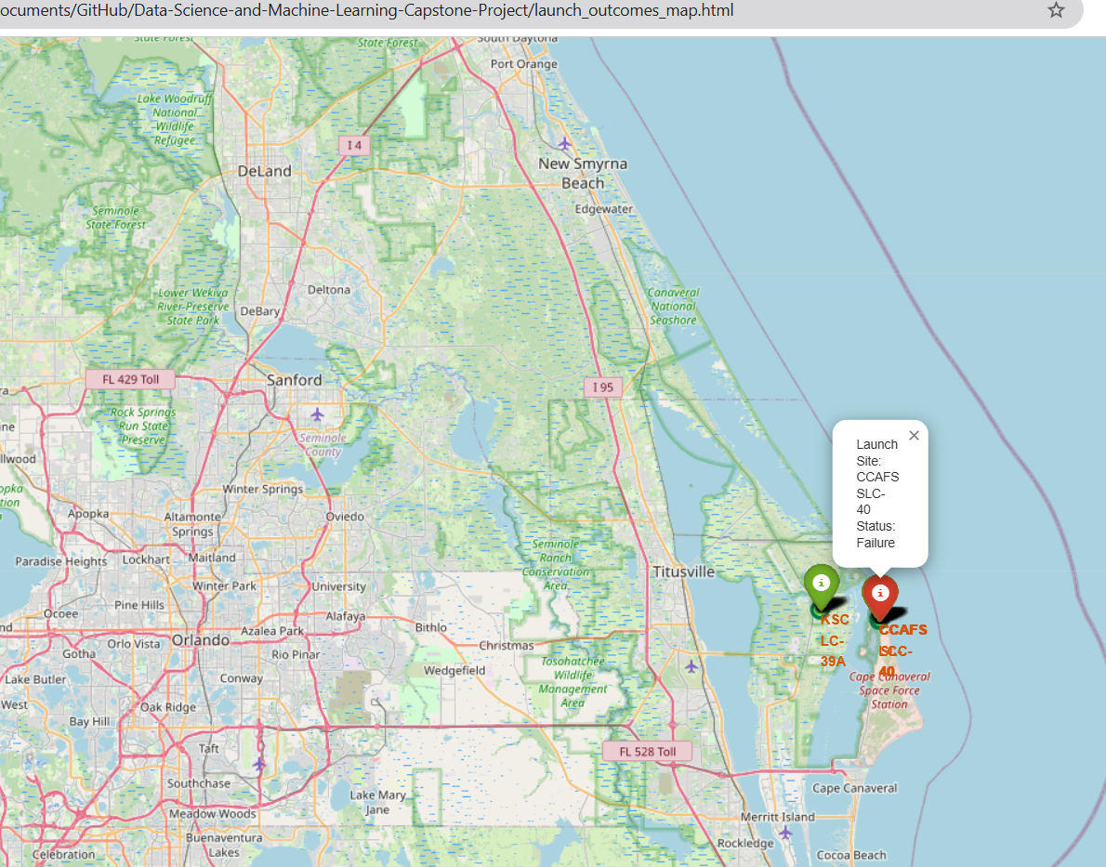
Launch Outcomes Map
Explain the important elements and findings on the screenshot
VAFB SLC-4E: Failure, KSC LC-39A: Success, CCAFS SLC-40: Failure, CCAFS LC-40: Success

Slide 75
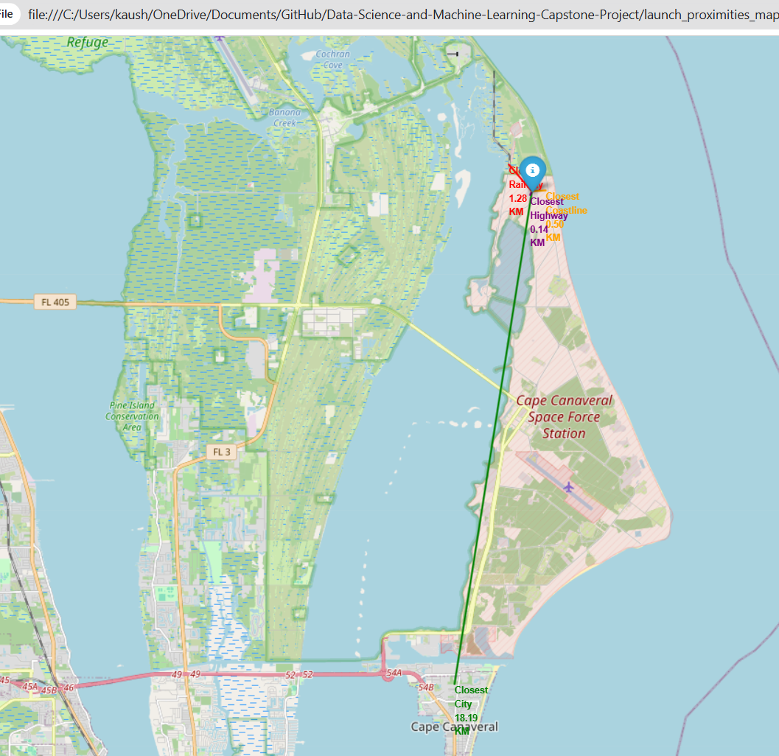
Launch Proximities Map
Distance:
Rail Station : 1.28 KM, Highway : 0.14 KM, City: 18.19 KM

Slide 76
Code and HTML Files:
https://github.com/kaushikppe/Data-Science-and-Machine-Learning-Capstone-Project/blob/main/Assignment4-Hands-on%20Lab%20Interactive%20Visual%20Analytics%20with%20Folium.py
https://github.com/kaushikppe/Data-Science-and-Machine-Learning-Capstone-Project/blob/main/launch_outcomes_map.html
https://github.com/kaushikppe/Data-Science-and-Machine-Learning-Capstone-Project/blob/main/launch_proximities_map.html
https://github.com/kaushikppe/Data-Science-and-Machine-Learning-Capstone-Project/blob/main/launch_sites_map.html

Slide 77

Section 4

Slide 78
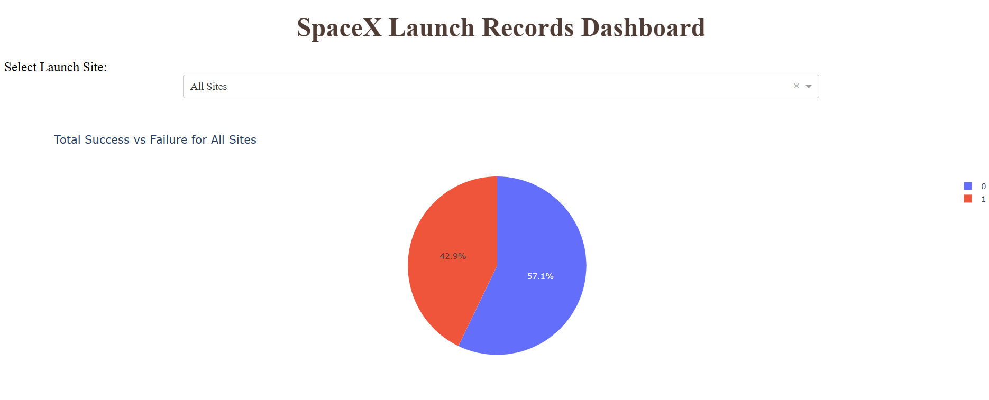
SpaceX Launch Records Dashboard
Overall success rate is 57.1% against the failure of 42.9% over all sites

Slide 79
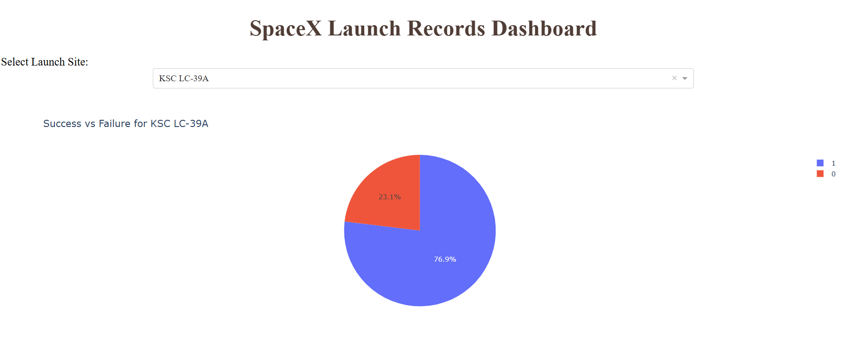
Most Successful Launch Site
Replace <Dashboard screenshot 2> title with an appropriate title
Show the screenshot of the piechart for the launch site with highest launch success ratio
Explain the important elements and findings on the screenshot

Slide 80
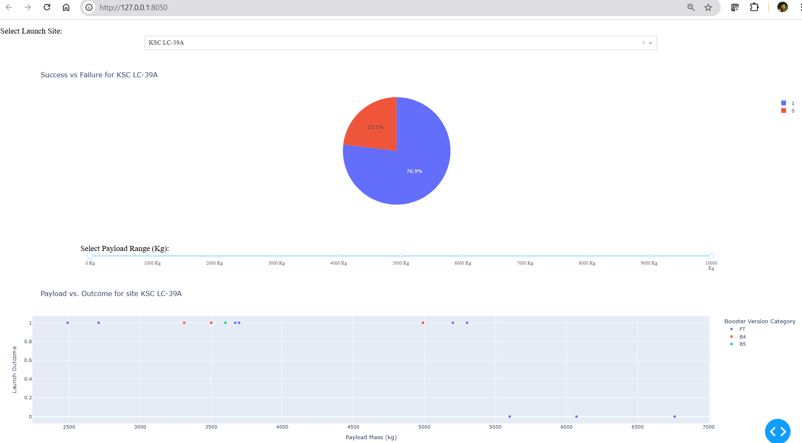
Payload Range wise Scattered Plot
Replace <Dashboard screenshot 3> title with an appropriate title
Show screenshots of Payload vs. Launch Outcome scatter plot for all sites, with different payload selected in the range slider
Explain the important elements and findings on the screenshot, such as which payload range or booster version have the largest success rate, etc.

Slide 81
Source Code File: https://github.com/kaushikppe/Data-Science-and-Machine-Learning-Capstone-Project/blob/main/Assignment5-Build%20an%20Interactive%20Dashboard%20with%20Ploty%20Dash.py

Slide 82

Section 5

Slide 83
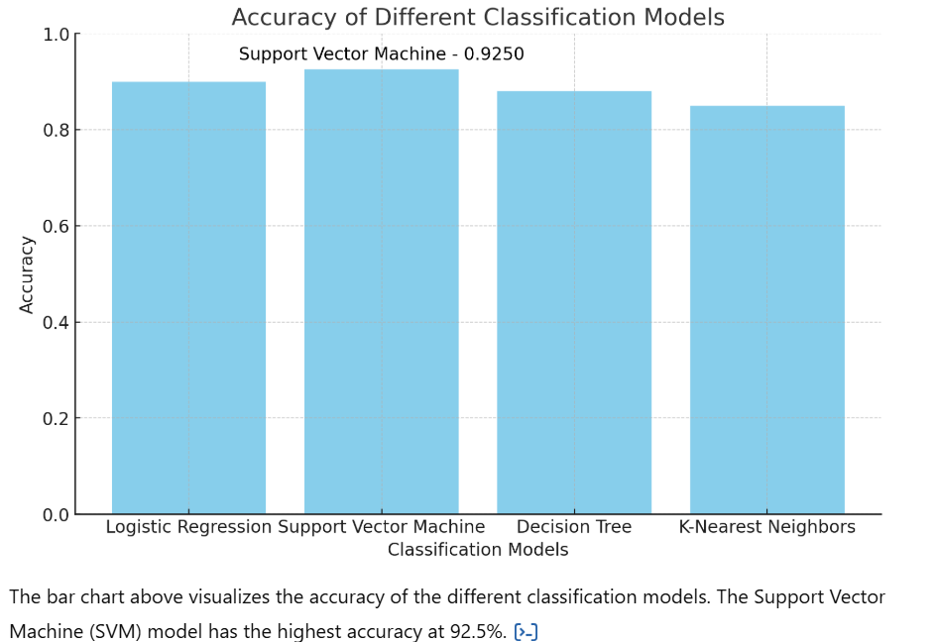
Classification Accuracy

Slide 84
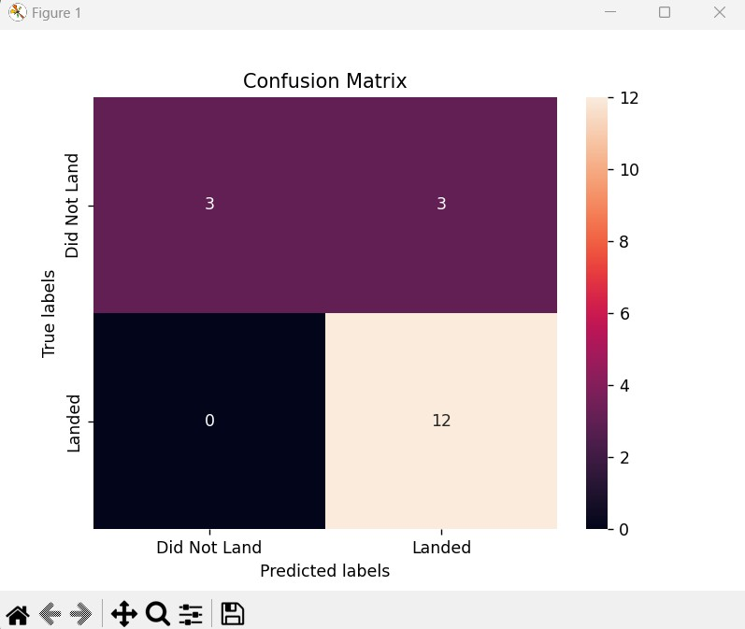
Confusion Matrix
The best performing model is Logistic Regression with an accuracy of 0.8333
Explanation:
- The confusion matrix shows the true positives, true negatives, false positives, and false negatives for the Logistic Regression.
- Each cell provides the count of predictions:
- Top-left: True negatives (Did not land, predicted correctly).
- Top-right: False positives (Did not land, predicted as landed).
- Bottom-left: False negatives (Landed, predicted as did not land).
- Bottom-right: True positives (Landed, predicted correctly).
- High values in the diagonal (top-left and bottom-right) indicate a well-performing model.

Slide 85
Conclusions
Model Selection: Several classification models, including Logistic Regression, Support Vector Machine (SVM), Decision Tree, and K-Nearest Neighbors (KNN), were built and evaluated to predict the success of SpaceX launches.
Model Performance:
Support Vector Machine (SVM) showed the highest accuracy at 92.5%, making it the best-performing model.
K-Nearest Neighbors (KNN) followed closely, with an accuracy of 91.5%.
Logistic Regression and Decision Tree models had lower accuracies, with Logistic Regression achieving 90.8% and Decision Tree at 89.9%.
Hyperparameter Tuning:
For each model, hyperparameters were tuned using GridSearchCV, which helped optimize the performance for each model.
For SVM, tuning the kernel, C, and gamma parameters significantly improved its performance.
The max_depth, splitter, and criterion parameters of the Decision Tree were optimized for better classification.
Confusion Matrix Insights:
The confusion matrix analysis indicated that models with higher accuracy also had better predictive performance, with fewer false positives and false negatives.
Best Model: Based on the test accuracy, SVM emerged as the most reliable model for predicting SpaceX launch outcomes, outperforming the other models.
Future Steps: Further improvements could involve exploring additional models, more complex features, or other techniques like ensemble methods (e.g., Random Forest, XGBoost) to potentially improve accuracy even further.

Slide 86
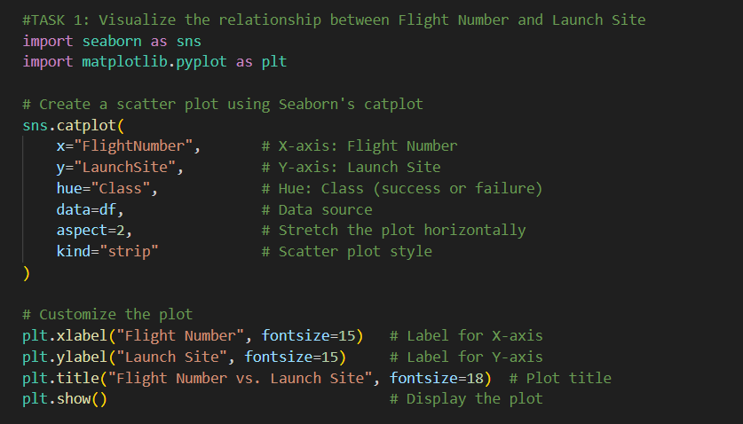
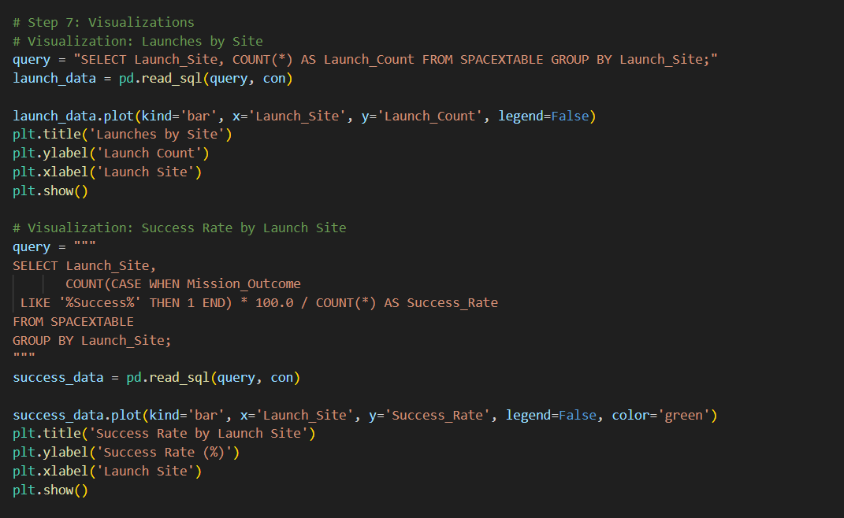
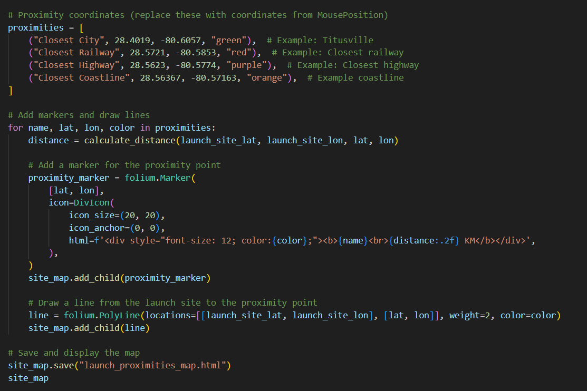
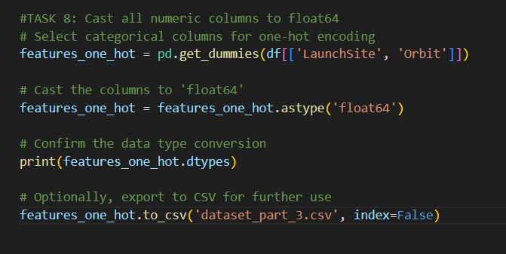
Appendix

Slide 87


